Slide 1
Session 3:METHODOLOGY
Bayesian Sensor Fusion &
Gaussian Process Mapping
For Human–Robot Collaborative Hygiene Monitoring and Surface Disinfection
Case Study Assistive Robotics for Improvement Quality of Life
Presented by:
Alwa Jyoshna
Vallepu Vishnu
Kappala Mahesh

Slide 2
SESSION OUTLINE
1
Research Problem Statement
2
Modelling Approach — Bayesian Sensor Fusion
3
Spatial Mapping — Gaussian Process Regression
4
Model Inputs, Assumptions & Data Sources
5
Decision Policy & HRC Rules
6
End-to-End Process Flowchart

Slide 3
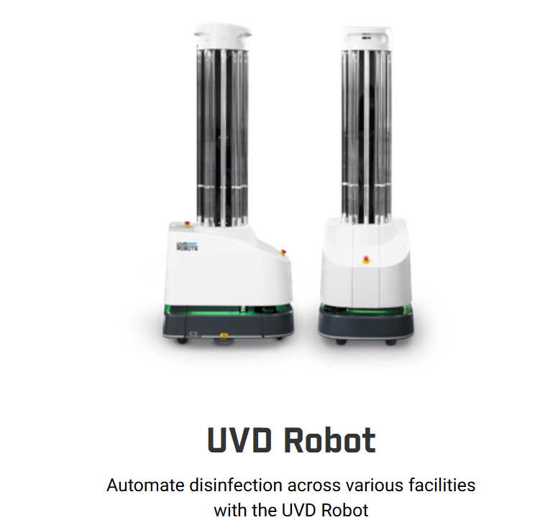
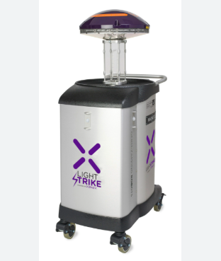
Existing Disinfection Robots:
Xenex Robot

Slide 4
RESEARCH CONTEXT & PROBLEM STATEMENT
LIMITATIONS
Proposed Framework Addresses:
No automatic contamination estimation
Bayesian Fusion — Combines 4 sensor modalities optimally
Shadowed areas may not receive UV light
GP Spatial Map — Covers observed + unobserved patches
Sensors used in isolation, not fused
Calibrated Uncertainty — Quantified confidence at every patch
No spatial hygiene map for unobserved areas
HRC Decision Rules — Autonomy where safe, human input where uncertain
Full cognitive burden remains with operator
Cleanliness Verification — Probabilistic, not just path-level

Slide 5
MAIN MODELLING APPROACH
LAYER 1
Sensing
LAYER 2
Bayesian Fusion
LAYER 3
GP Mapping
LAYER 4
Decision Policy
Raw multi-modal data acquisition
Fluorescence (T1,T2) · ATP (T7)
Precision-weighted posterior per patch
Closed-form Gaussian estimator
Spatial interpolation via RBF kernel
Full probabilistic hygiene map (9/9 coverage)
Priority score · UV exposure time
HRC collaboration rules
Each layer is independently modular and replaceable without affecting the others

Slide 6
BAYESIAN MULTI-SENSOR FUSION — MODEL
Sensor Measurement Model
Closed-Form Posterior
z_{m,i} = f_i + ε_m, ε_m ~ N(0, σ²_m)
Posterior Precision:
σ⁻²_fused = σ⁻²₀ + Σ σ⁻²_m
Fluorescence
σ² = 0.01
T1 Toilet, T2 Chair — precision 100
Posterior Variance:
ATP
σ² = 0.02
σ²_fused = 1 / (σ⁻²₀ + Σ σ⁻²_m)
T7 Door handle — precision 50
Posterior Mean:
Prior belief
σ² = 0.09
Neutral start (μ₀ = 0.5)
μ_fused = σ²_fused · (μ₀/σ²₀ + Σ z_m/σ²_m)
Fused variance
0.011
Key Property: σ²_fused < σ²_m for all m
→ Adding any sensor always reduces uncertainty
87.3% uncertainty reduction

Slide 7
GAUSSIAN PROCESS SPATIAL MAPPING
GP Prior
Hygiene Map — 3×3 Grid Example
f(x) ~ GP( μ₀, k(x, x') )
T7
0.772
T8
0.576
T9
0.576
RBF Kernel: k(xᵢ,xⱼ) = σ²_f · exp(−‖xᵢ−xⱼ‖²/2l²)
observed
GP est.
GP est.
Length-scale l = 1.0, Signal variance σ²_f = 1.0
T4
0.576
T5
0.576
T6
0.576
GP Posterior Equations
GP est.
GP est.
GP est.
μ_* = K_*ᵀ (K + Σ_n)⁻¹ y
T1
0.689
T2
0.267
T3
0.576
Σ_* = K_** − K_*ᵀ (K + Σ_n)⁻¹ K_*
observed
observed
GP est.
Σ_n = diag(σ²_fused) from Bayesian fusion outputs
Disinfect
Monitor
Clean
GP Only

Slide 8
MODEL ASSUMPTIONS
Gaussian Sensor Noise
Independent Sensor Noise
A1
Each sensor error ε_m ~ N(0, σ²_m). Enables closed-form Bayesian posterior. May not hold for fluorescence on complex surfaces — approximate Bayes (EP/VI) needed if violated.
A4
Noise terms of different sensors are mutually independent. Simplifies the precision-sum formula. Cross-sensor correlations (e.g. both affected by lighting) would require a joint noise model.
Spatial Smoothness (RBF Kernel)
Stationary Contamination During Scan
A2
Contamination is spatially correlated with smooth decay over distance. RBF chosen for mathematical tractability. Sudden discontinuities (e.g. sealed patches) require Matérn kernel.
A5
Surface contamination does not change during a single robot traversal. Valid for single scans; requires recursive Bayesian / Kalman filter extension for continuous temporal monitoring.
Contamination ∈ [0, 1]
Known Sensor Noise Variances
A3
Scalar bounded representation f_i ∈ [0,1]. Interpretable and compatible with both fusion and GP. Assumes all modalities can be normalised to this range prior to fusion.
A6
σ²_m values are set from literature. In practice, these must be empirically calibrated from controlled experiments on known ground-truth surfaces before hardware deployment.

Slide 9
REQUIRED INPUTS & DATA SOURCES
Input / Parameter
Type
Value / Source
Used In
Surface patch coordinates x_i
Model input
Integer grid {0,1,2}²
GP kernel
Prior mean μ₀
Model param.
0.5 (neutral belief)
Bayesian fusion
Prior variance σ²₀
Model param.
0.09 (literature)
Bayesian fusion
Fluorescence z_F (T1,T2)
Sensor data
900, 161 RLU (Fieldhouse 2025)
Fusion layer
ATP reading z_ATP (T7)
Sensor data
907 RLU (Niephaus 2024)
Fusion layer
Sensor noise variances σ²_m
Calibration
Literature / empirical
Fusion weights
GP length-scale l
Hyperparameter
1.0 (cross-validation)
RBF kernel
GP signal variance σ²_f
Hyperparameter
1.0 (normalised)
RBF kernel
Touch frequency T_i
Domain knowledge
Clinical / expert input
Priority score

Slide 10
DECISION POLICY & HRC RULES
Priority Score
μᵢ = contamination estimate | σᵢ = uncertainty | Tᵢ = clinical importance
Pᵢ = w₁·μᵢ + w₂·σᵢ + w₃·Tᵢ
Adaptive UV Dose
D_req = D_base · (1 + λ·μᵢ + κ·σᵢ) → t_i = D_req / I_i
IF: μᵢ > 0.7
IF: σᵢ > 0.3
THEN: AUTONOMOUS DISINFECT
THEN: REQUEST HUMAN INSPECT
High-confidence contamination detected
Uncertainty too high for autonomous action
IF: Proximity detected
IF: μᵢ < 0.2 & σᵢ < 0.1
THEN: PAUSE UV → SAFETY
THEN: CERTIFY CLEAN
UV source halted until human clears area
Both contamination and uncertainty below threshold

Slide 11
END-TO-END PROCESS FLOWCHART
1. Start: Robot Traversal Begins
5. ◆ HRC Decision Rule Applied
2. Multi-Sensor Data Acquisition (RGB-D · Fluorescence · Hyperspectral · UV-dose)
DISINFECT
(μ > 0.7)
CONFIRM
(σ > 0.3)
3. Bayesian Fusion per Patch → (μ_fused, σ²_fused)
PAUSE
(proximity)
CLEAN ✓
(μ<0.2)
4. GP Regression over Surface → Full Hygiene Map H(xᵢ)
6. Update Priority Queue & Map Log
7. All Patches Done? → End / Next Traversal

Slide 12
KEY ANALYTICAL RESULTS
87.3%
2×
9 / 9
4
Variance Reduction
vs Prior
Fluorescence precision
vs ATP (100 vs 50)
Spatial Coverage
(vs 3/9 Kalman)
HRC Decision
Categories
Method Comparison
Method
MSE (Variance)
Coverage
Full Map
Prior only
0.09000
0/9
No
Fluorescence Only
0.01000
3/9
No
Kalman filter
0.00000
3/9
No
Bayesian Fusion
0.01145
3/9
No
Proposed (Bayes+GP)
0.00512*
9/9
Yes ✓
* At the 3 observed tiles. Kalman matches Bayesian fusion there but covers only 3/9; GP reaches all 9 tiles with bounded extra uncertainty.

Slide 13
METHODOLOGY SUMMARY
Framework at a Glance
Sensing
Fusion
2 sensors — Fluorescence (T1,T2) and ATP (T7), real RLU values
Precision-weighted Bayesian posterior → 87.3% variance reduction
Mapping
Decision
RBF-kernel GP regression → 9/9 spatial coverage
Priority score + adaptive dose + 4 HRC collaboration rules
Analytical validation on 3×3 grid confirms mathematical feasibility — simulation & hardware validation as next steps

